Slide 1


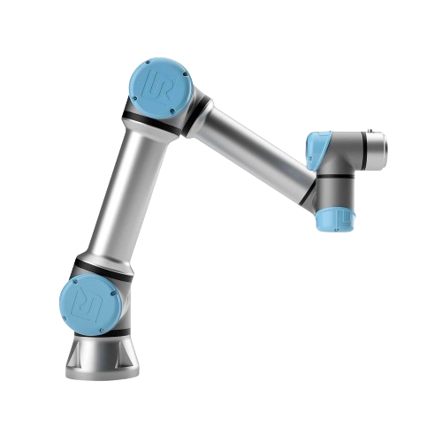
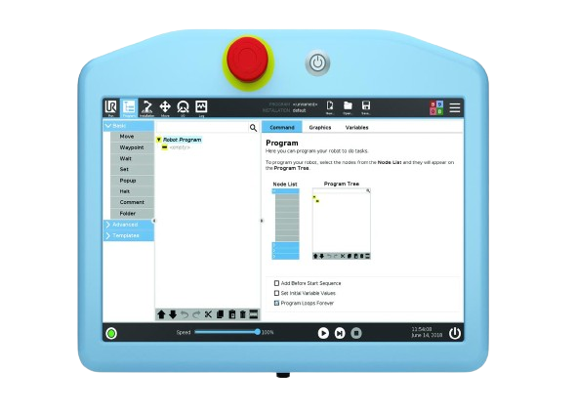
MQTT* ROBOT CONTROL
Control of a UR-10e robot
*Message Queuing Telemetry Transport

Slide 2
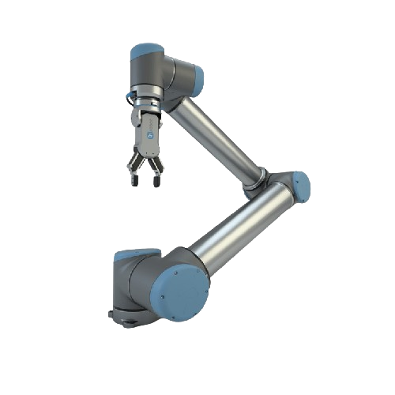
Objective
The purpose of this project is to be able to control a Universal Robot brand robot using wireless voice control.
01010101
Feature : move one x,y,z | rotate tool on x,y,z | active the tool | stop | freedrive

Slide 3


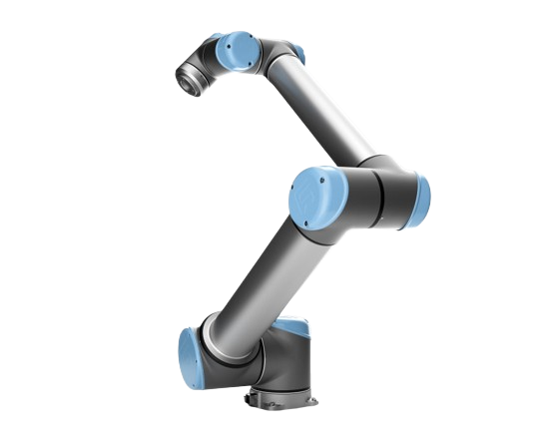

Pipline
Script Python
Text
Text-to-intent engine
Vocal instruction
User
Speech to text engine
Playload
MQTT Robot State
MQTTs request order
Cobot
MQTTs Broker

Slide 4
Speech-to-text
Local Whisper AI
Text
Text-to-intent engine
Vocal instruction
User
Speech to text engine
Playload
MQTT robot state
MQTTs request order
Robot
MQTTs Broker

Slide 5
Text-to-intent
Gemini for text-to-intent
Text
Text-to-intent engine
Vocal instruction
User
Speech to text engine
Playload
MQTT Robot State
MQTTs request order
Cobot
MQTTs Broker

Slide 6
MQTT publish
JSON to MQTT Broker
Text
Text-to-intent engine
Vocal instruction
User
Speech to text engine
Playload
MQTT Robot State
MQTTs request order
Cobot
MQTTs Broker

Slide 7
Robot processing
Text
Text-to-intent engine
Vocal instruction
User
Speech to text engine
Playload
MQTT Broker to Robot
MQTT Robot State
MQTTs request order
MQTTs Broker
Cobot

Slide 8
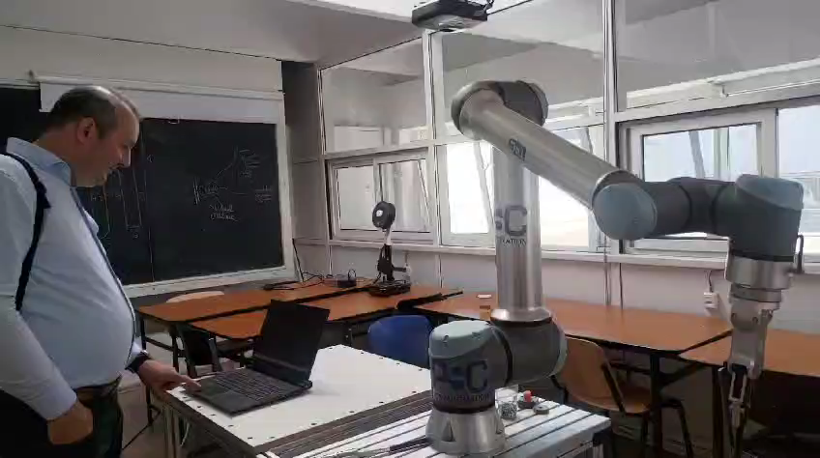
Video

Slide 9
Thanks!

Slide 10
Questions

